Slide 1
Business Strategy Canvas

Slide 2
Business Model Canvas – Current State

Slide 3
Business Model Canvas – Ideas

Slide 4
Business Model Canvas –Desired State

Slide 5
Product Strategy Canvas

Slide 6

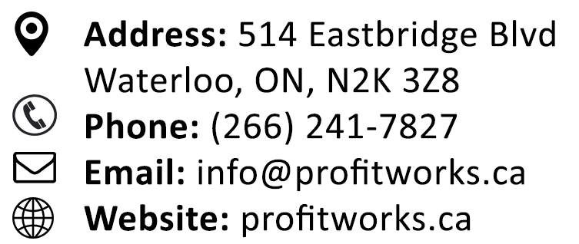
Profitworks
Love What You Do

